Slide 1
Joint Prioritised Effects List (JPEL)
Brigadier Lisa Ferris, Director of Defence Legal Services
Government Inquiry into Operation Burnham: Module 3 (29-30 July 2019)
UNCLASSIFIED

Slide 2
JPEL
“a process, through which military commands and staff seek to prioritise their efforts and resources…in a dynamic and fluid environment like Afghanistan it assisted in giving order, rigour and process to what a force was using scarce military resources for…The process underpinning the JPEL sought to assign the right asset to the right target at the right time. It also sought to ensure that those persons or capabilities or targets presented on the JPEL were legitimate and lawful targets in accordance with all ROE and informed legal advice. This includes ensuring that this form of targeting did not violate the Laws of Armed Conflict…From a national perspective the JPEL and other formal targeting processes used by ISAF gave a degree of assurance”.
    - Sir Angus Houston, former Chief of the Defence Force of Australia, Presentation to Operation Burnham Inquiry, Module 1 hearing, 4 April 2019.
UNCLASSIFIED

Slide 3
Roadmap of presentation
  The specific legal principles relevant to targeting and the JPEL process, and the concept of direct participation in hostilities (DPH).
  The process by which individuals were placed on and kept on the JPEL; and how it applied in practice, including safeguards, training, and Afghan involvement.
UNCLASSIFIED

Slide 5
UNCLASSIFIED

Slide 9
ROE training example

Slide 10
New Zealand ROE
Rule H: Attack on individuals, forces or groups directly participating in hostilities in Afghanistan against the legitimate Afghan government, including [redacted] is permitted.
AMPL/1/ Planned attacks subject to approval at the authorisation level for [redacted].
AMP/2/ Positive confirmation by [redacted] that a target is directly participating in hostilities is required.
Rule A: Use of minimum force, up to and including deadly force, is permitted for individual or unit self defence or in defence of designated persons against a hostile act or demonstration of hostile intent.
UNCLASSIFIED

Slide 12
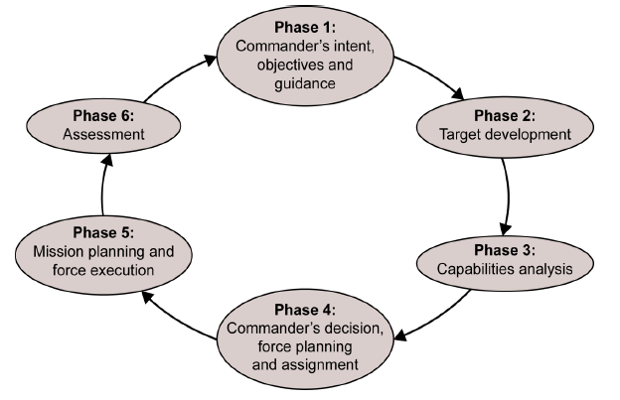
The joint targeting cycle
Source: NATO Standard AJP-3.9 Allied Joint Doctrine for Joint Targeting, Edition A Version 1, April 2016.
UNCLASSIFIED

Slide 13
New Zealand ROE
Rule G: Identification of targets is accepted if made by visual means or [other specified objective means]
Rule H: Attack on individuals, forces or groups directly participating in hostilities in Afghanistan against the legitimate Afghan government, including [redacted] is permitted.
  AMPL/1/ Planned attacks subject to approval at the authorisation level for [redacted].
  AMP/2/ Positive confirmation by [redacted] that a target is directly participating in hostilities is required.
Rule I: Actions which could result in incidental casualties and collateral damage are permitted if the action is essential for mission accomplishment and the expected incidental casualties and collateral damage are proportionate to the concrete and direct military advantage anticipated.
UNCLASSIFIED

Slide 15
Scenario – Minute 13
Imagine the New Zealand deployment in Bamyan Province after a long period of comparative peace has been the subject of violent attacks by insurgents through Improvised Explosive Devices, rocket-propelled grenades and shootings. Casualties have resulted. It is decided that the security situation has deteriorated, and action needs to be taken to restore order so as to provide some tranquillity for the local population and protection for the deployment.
Assume there is intelligence available as to the identity of the leaders of the insurgents who have conducted the attacks and the fact that they are planning to carry out further attacks.
Assume further that it is decided that the identified insurgents should be placed on the JPEL and that operations should be mounted to kill or capture them whenever the opportunity arises.
UNCLASSIFIED

